Slide 1
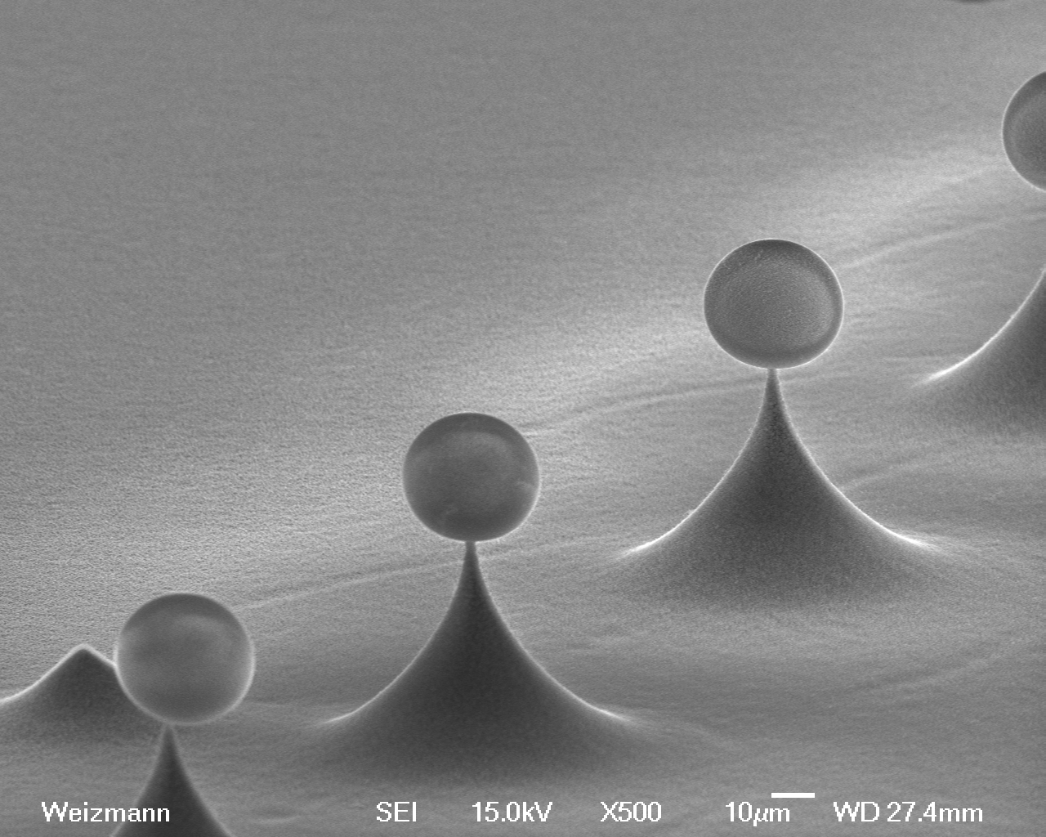



Cavity-QED with WGM resonators
Gabriel Guendelman
Barak Dayan's group

Slide 2
Outline
Motivation - Quantum links
Optical Resonators
An interface for light matter interaction
Why WGMs?
Cavity-QED experiment
Experimental system
Frequency locking
Single atom detection
Next-Generation setup

Slide 3
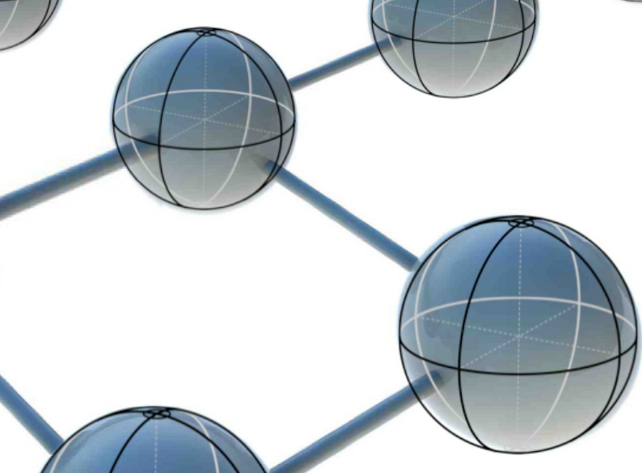
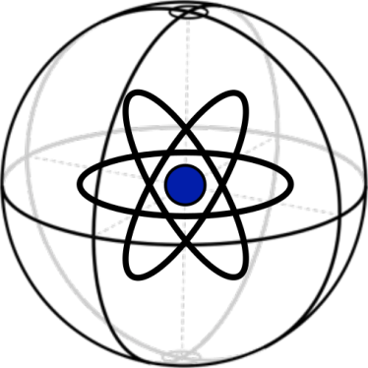
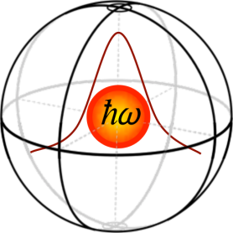

Quantum Links
Quantum network:
Nodes Processing & storage Material qubit
Channels Information transfer Photonic qubits
Interface for interacting
photonic/material qubits

Slide 4
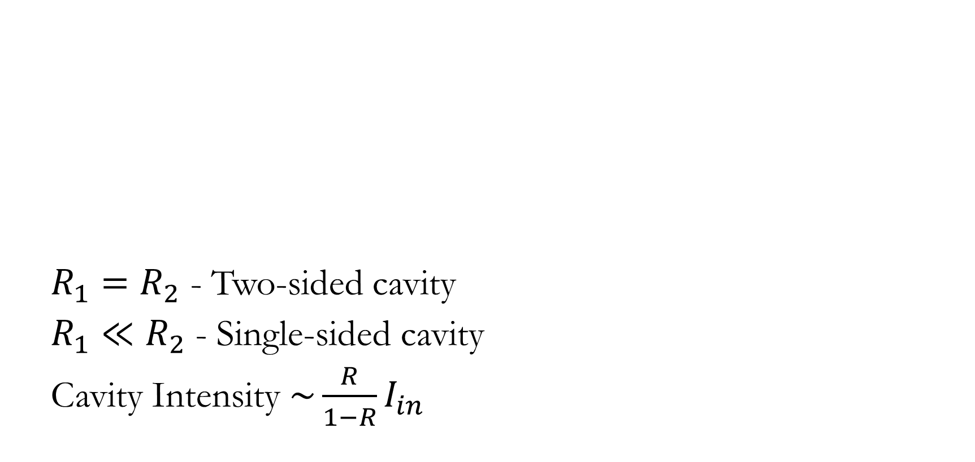
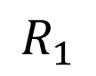
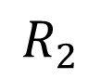
Optical resonators
$$R_{1}$$
$$R_{2}$$
$R_{1}=R_{2}$ - Two-sided cavity
$R_{1}≪R_{2}$ - Single-sided cavity
Cavity Intensity $\sim \frac{R}{1−R}I_{in}$

Slide 5
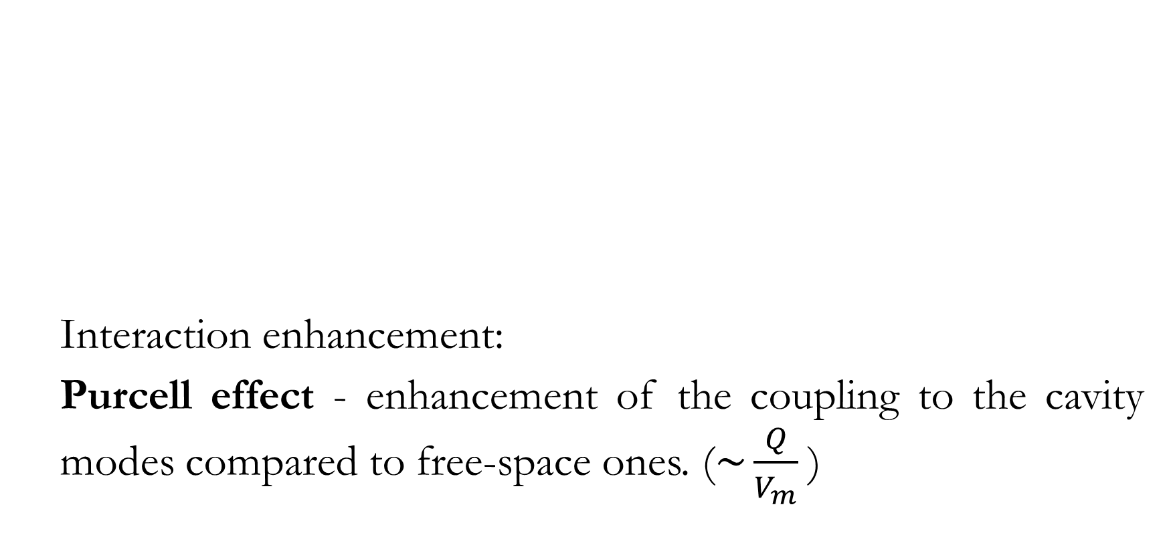
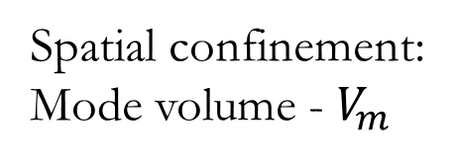
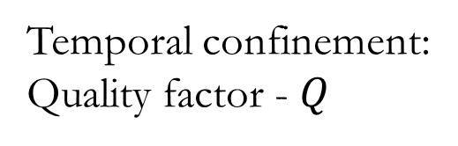
Optical resonators – important numbers
Spatial confinement:
Mode volume - $V_{m}$
Temporal confinement:
Quality factor - $Q$
Interaction enhancement:
Purcell effect - enhancement of the coupling to the cavity modes compared to free-space ones. ($\sim {\frac{Q}{V_{m}}}^{ }$)

Slide 6
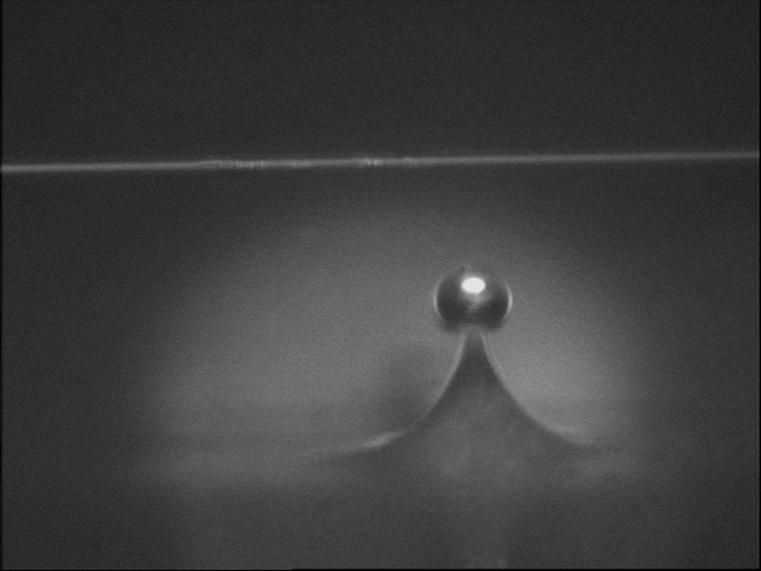
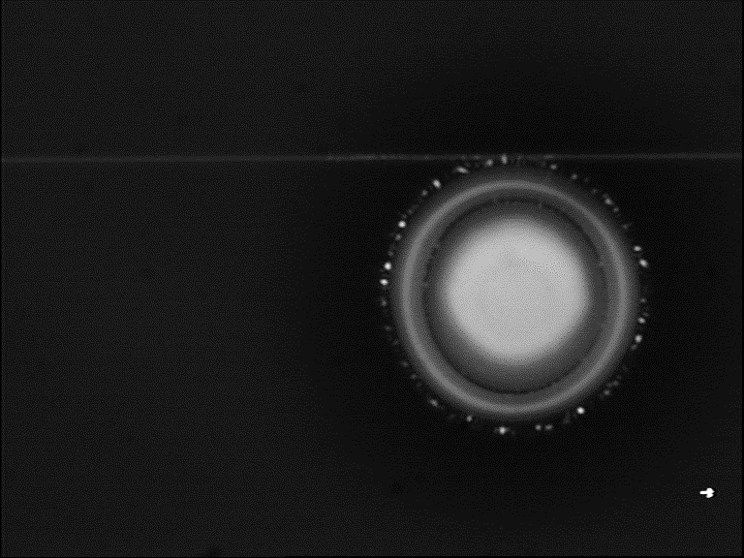
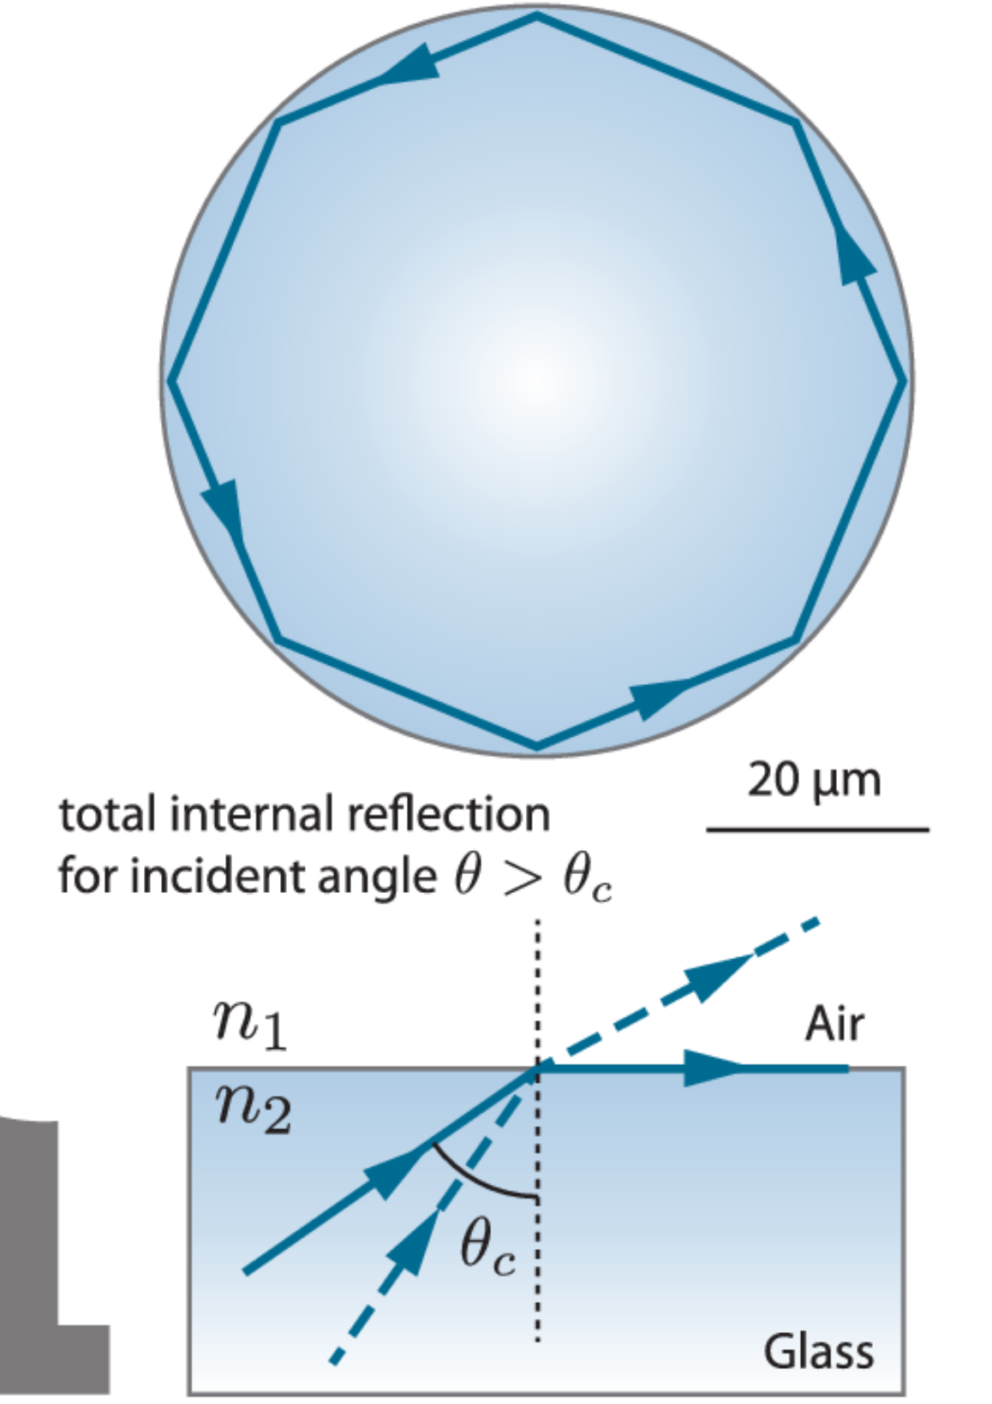
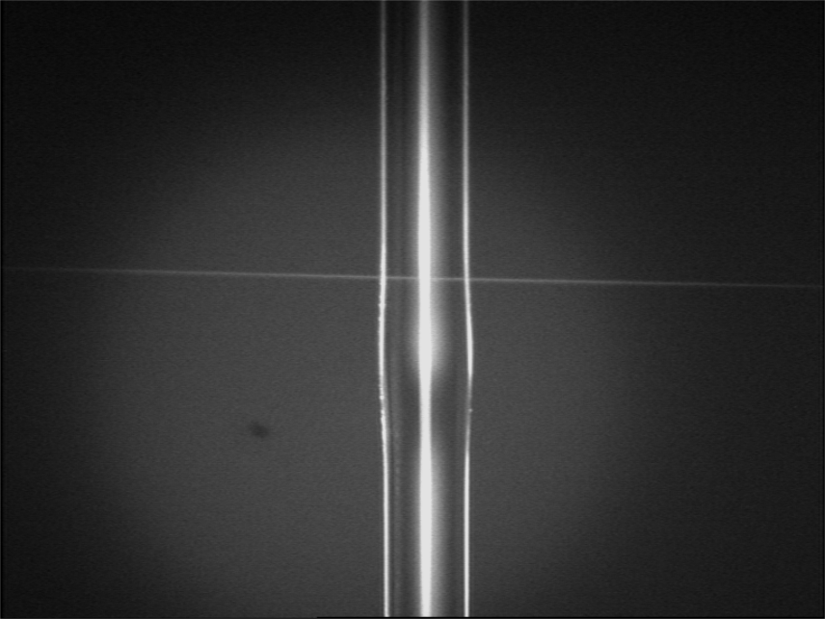
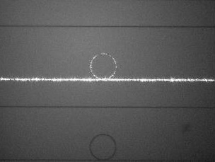
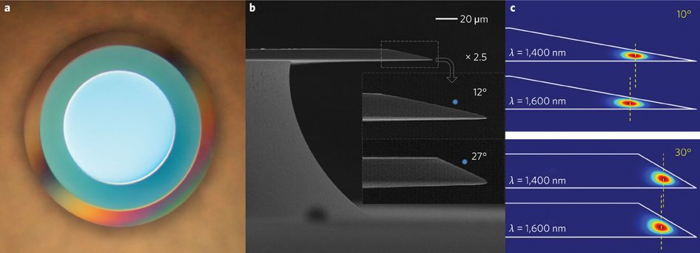
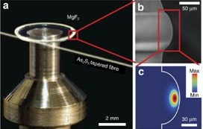
Whispering Gallery modes resonators
H. Lee, et.al., Nature Photonics, 6, 369–373(2012)
C, Lecaplain, et.al., Nature Communications,
7, 13383 (2016)

Slide 7
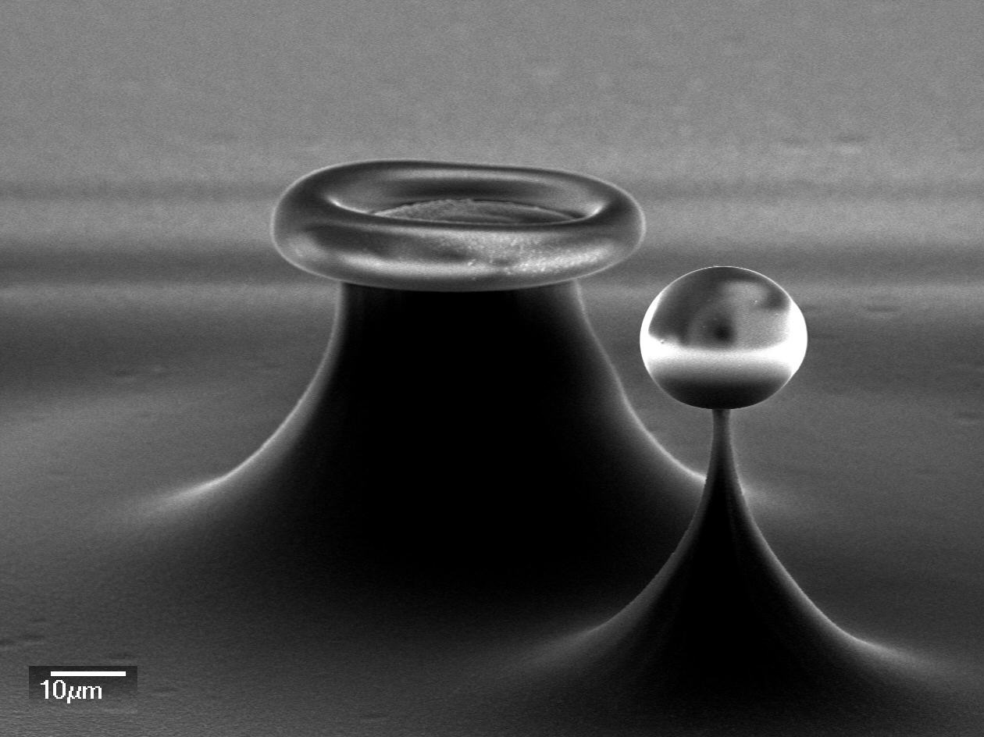
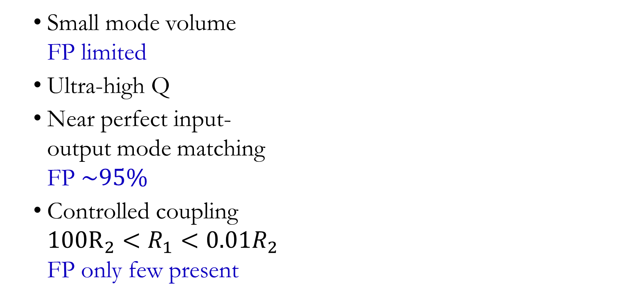
Why WGMs?
Small mode volume FP limited
Ultra-high Q
Near perfect input- output mode matching FP $\sim 95\%$
Controlled coupling $100R_{2}<R_{1}<0.01R_{2}$ FP only few present
Microtoroid
Microsphere

Slide 8
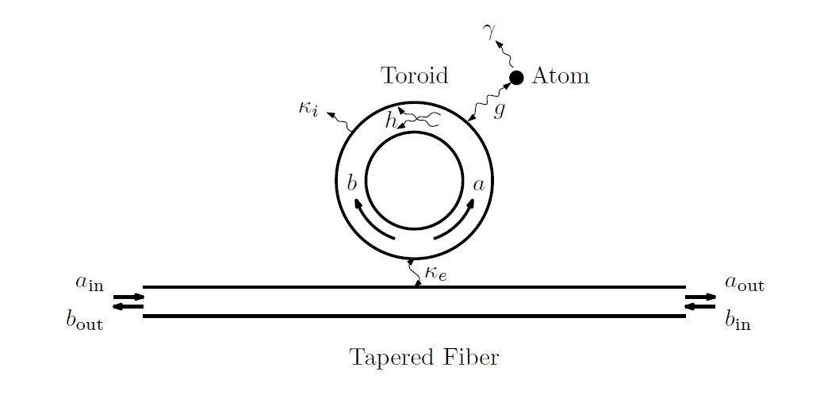
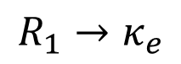
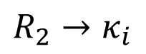
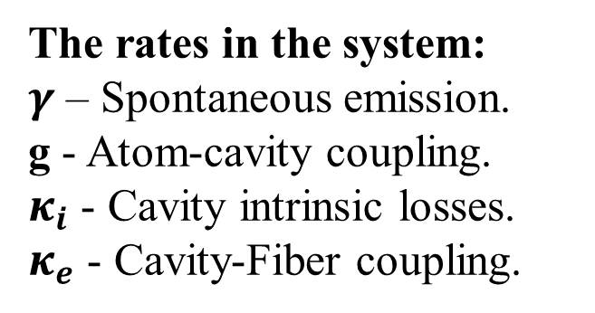
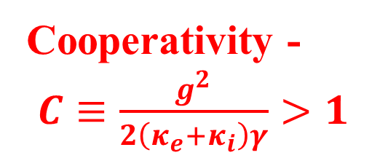
Important numbers
$$R_{1}→κ_{e}$$
$$R_{2}→κ_{i}$$
Cooperativity -
$C≡\frac{g^{2}}{2\left(κ_{e}+κ_{i}\right)γ}>1$
The rates in the system:
$γ$ – Spontaneous emission.
g - Atom-cavity coupling.
$κ_{i}$ - Cavity intrinsic losses.
$κ_{e}$ - Cavity-Fiber coupling.
Itay Shomroni PhD Thesis, 2014

Slide 9
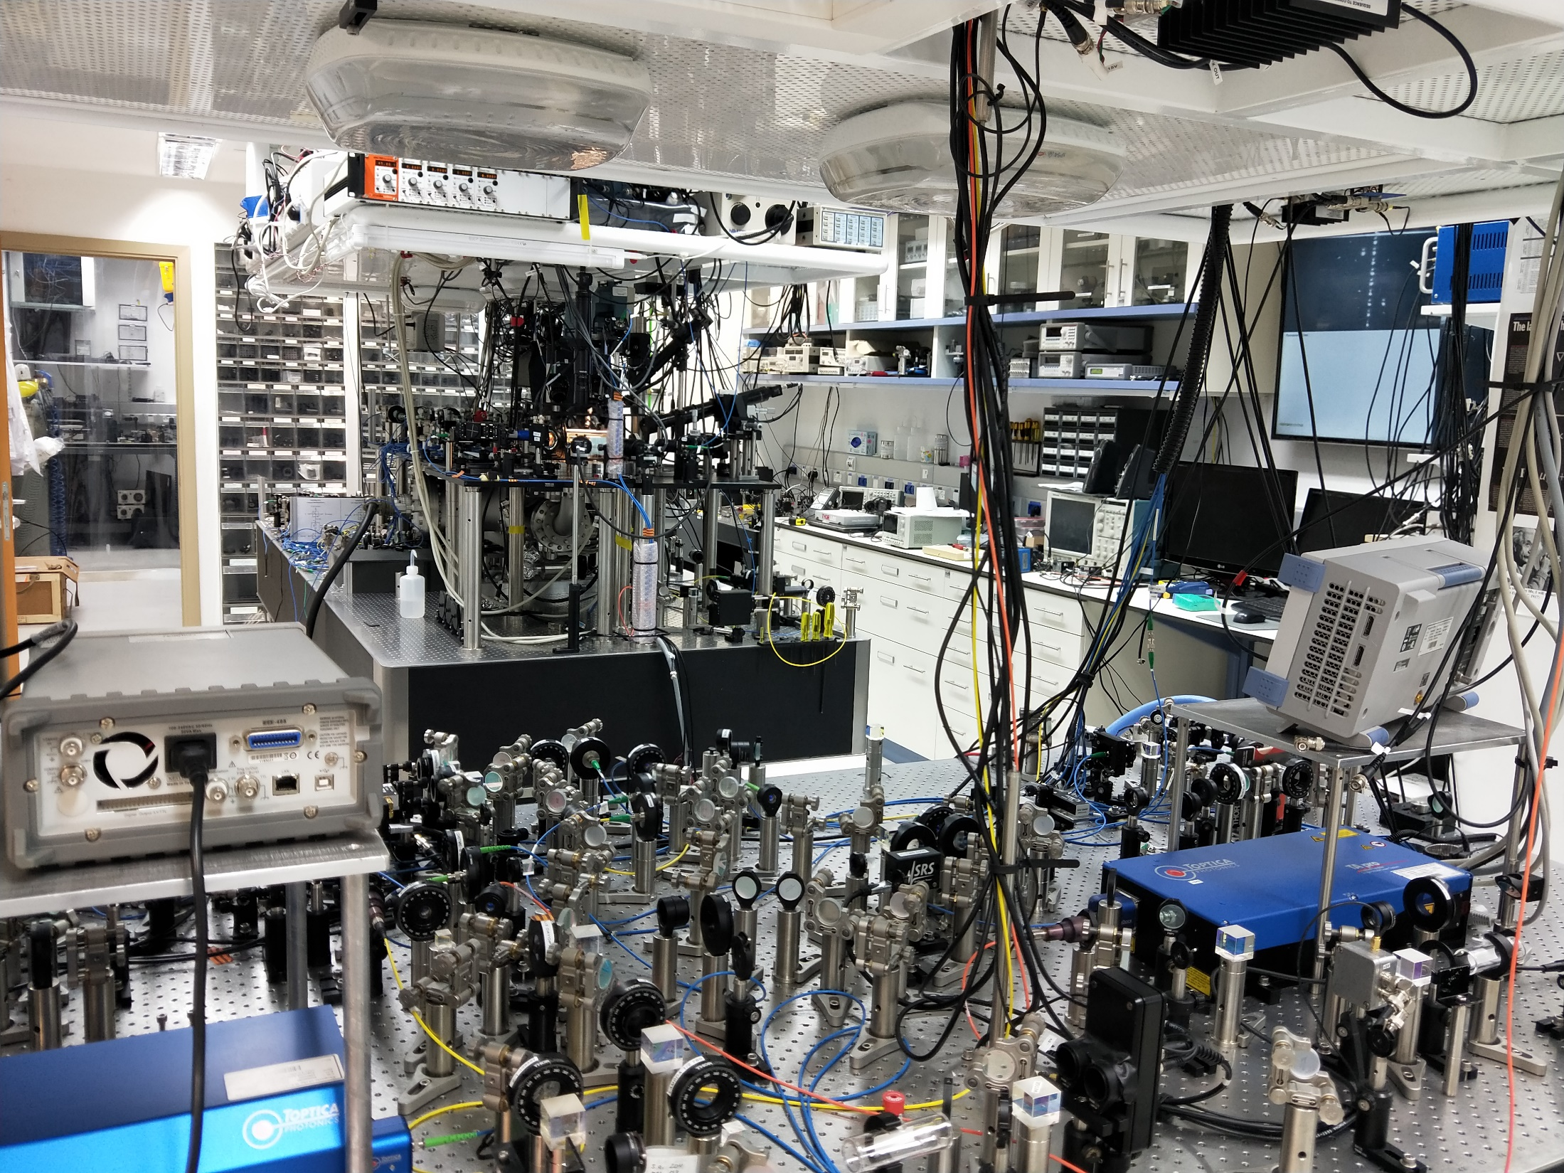
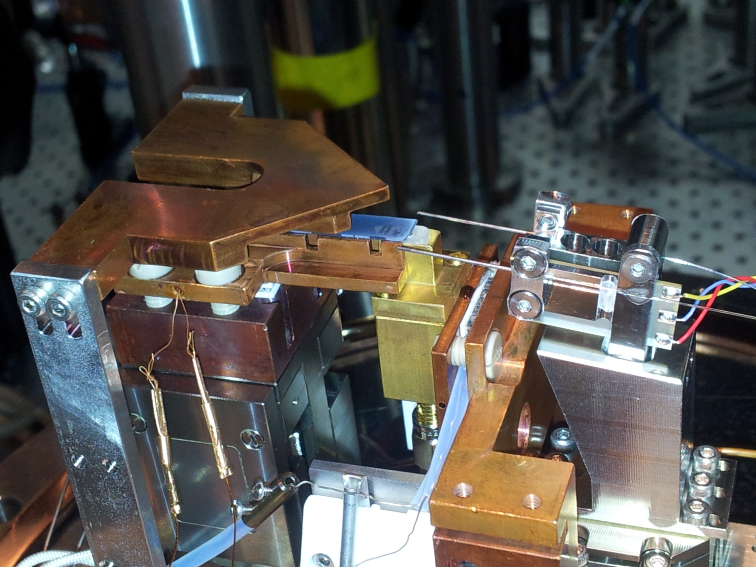
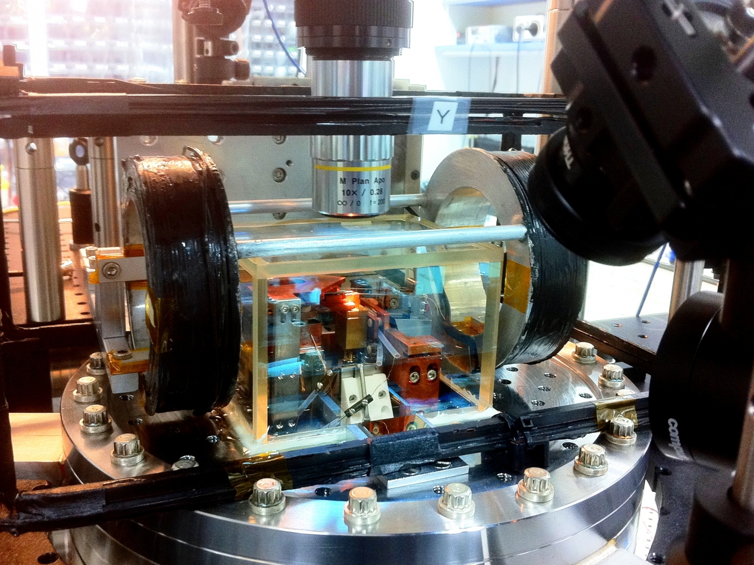
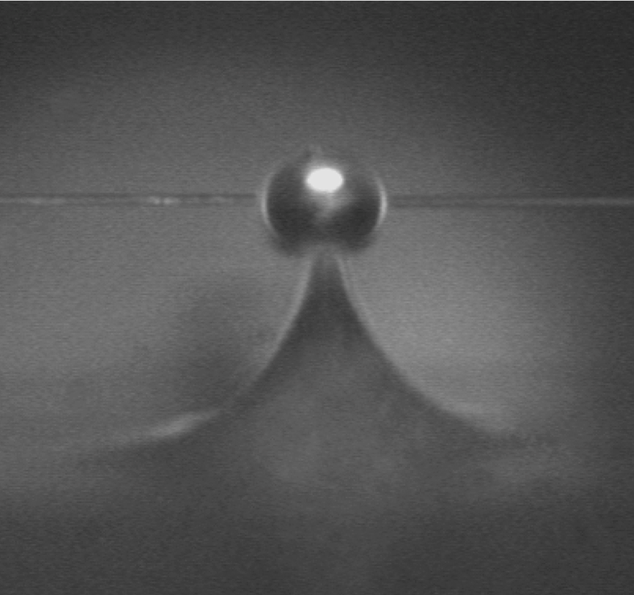
The system
Vacuum Chamber
MOT
Nanofiber
Tapered fiber
Vacuum Chamber
Microsphere Chip
Microsphere
Rb Depensers
Optic fiber

Slide 10
Coupling light
Nanofiber
Microsphere

Slide 11
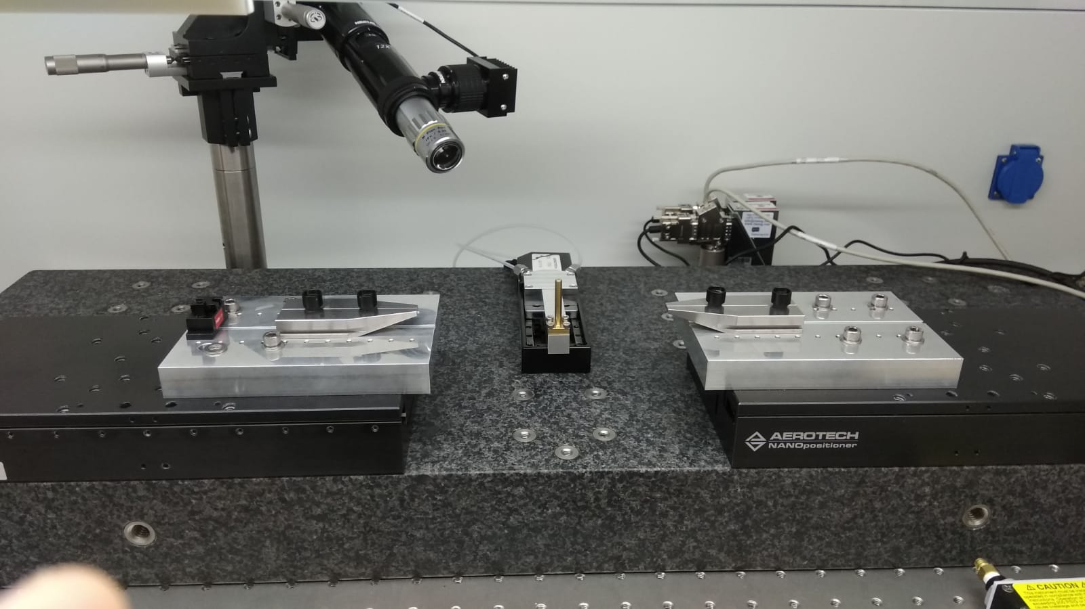
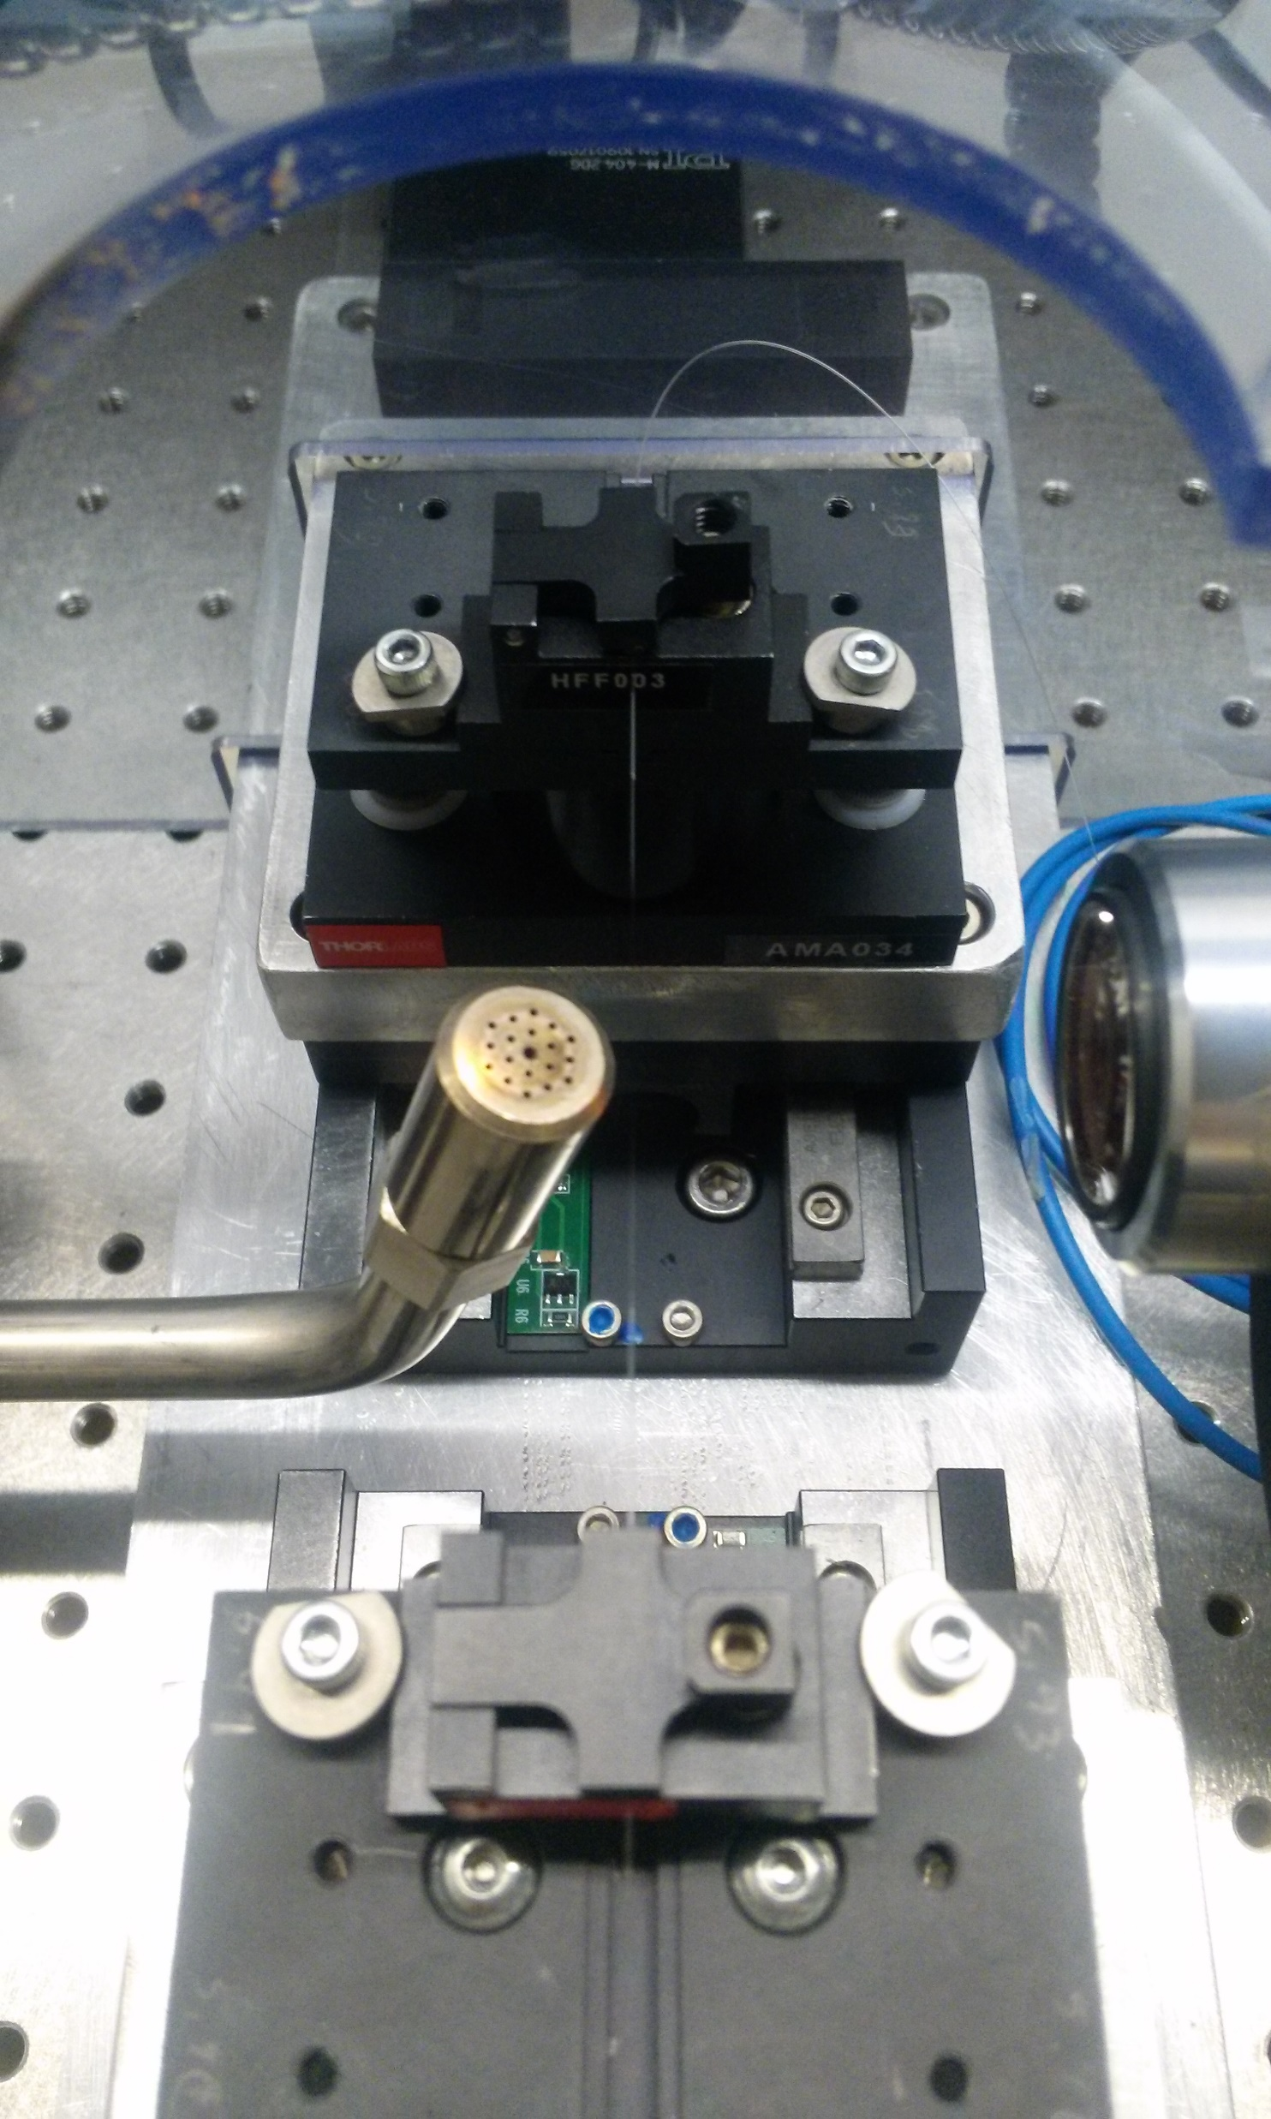
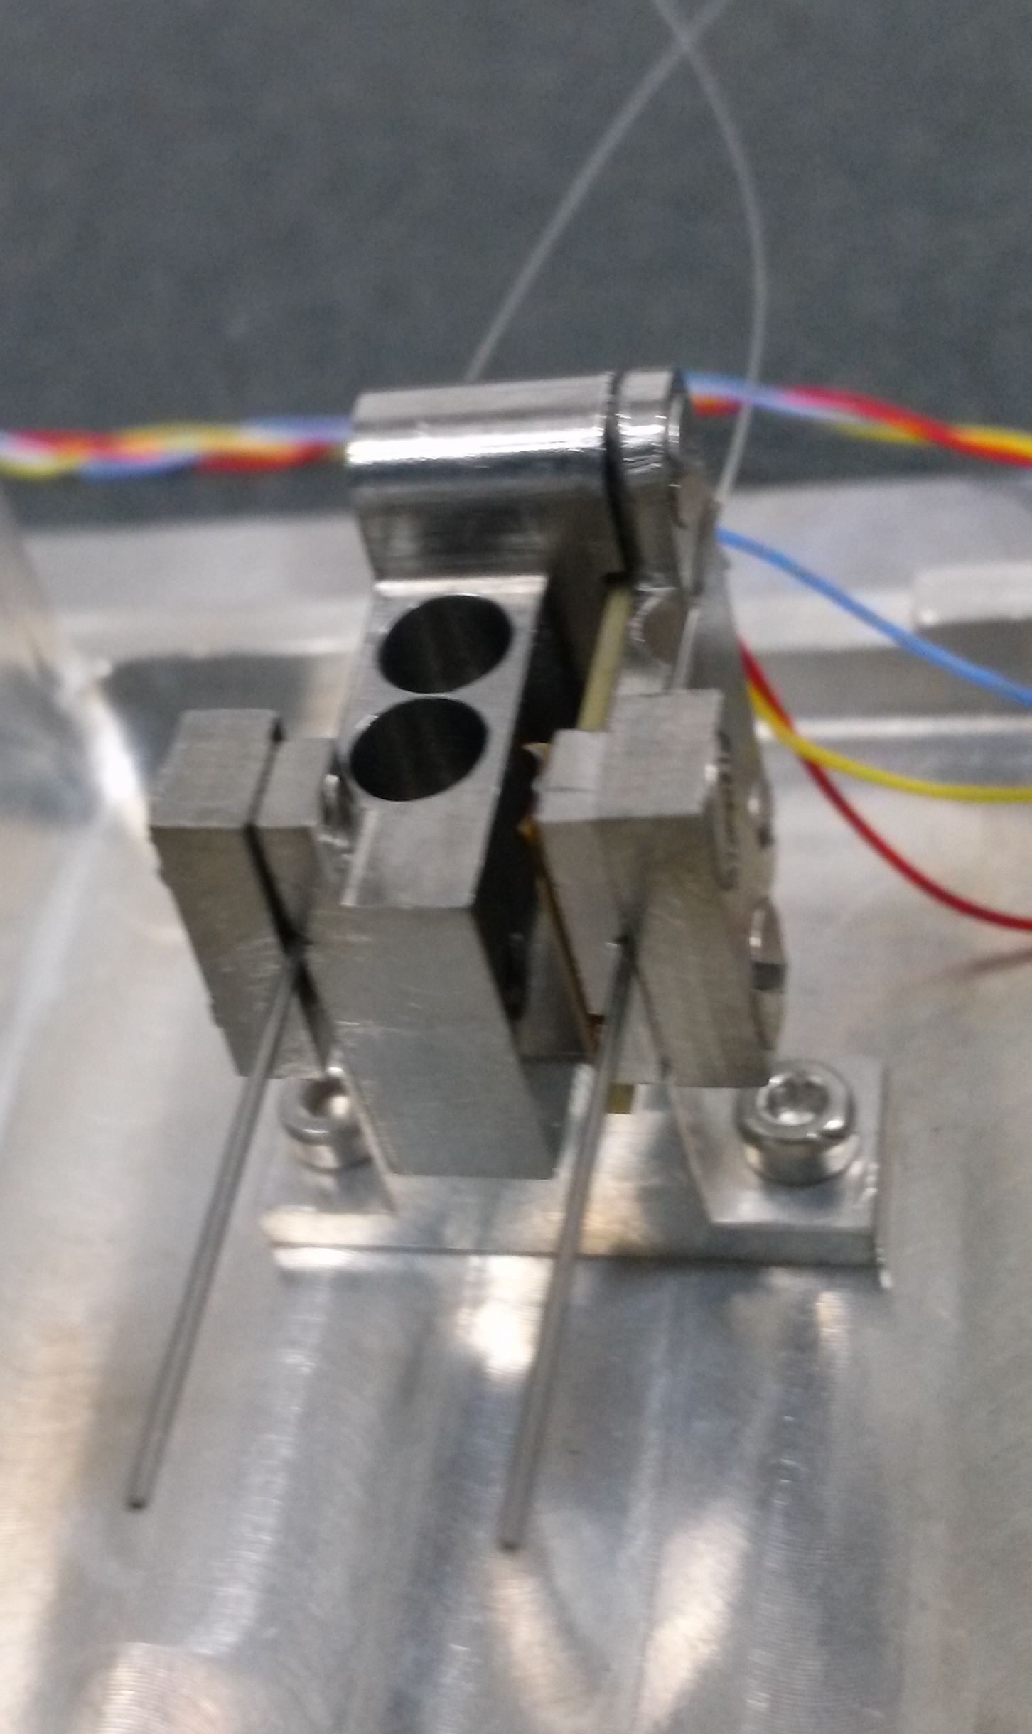
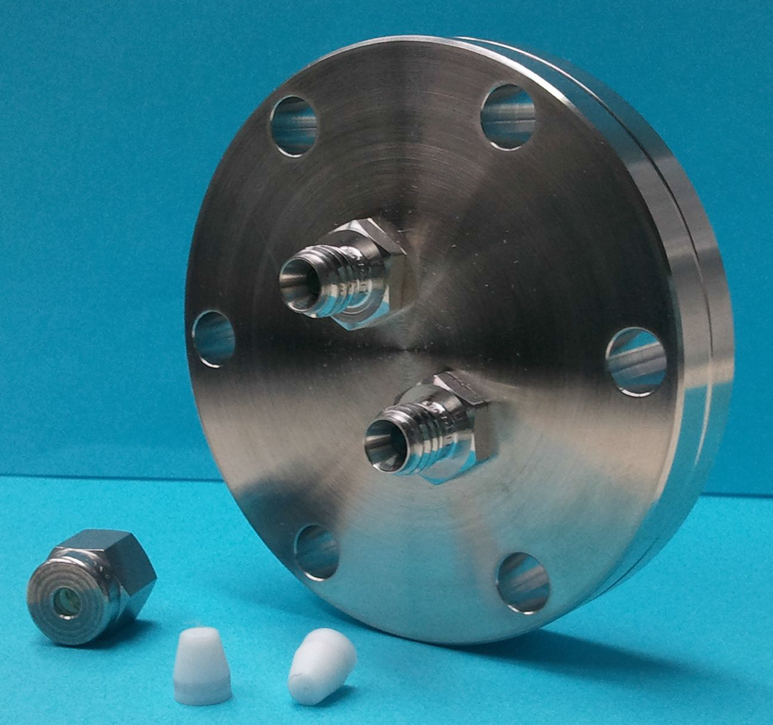
Fiber pulling & mounting

Slide 12
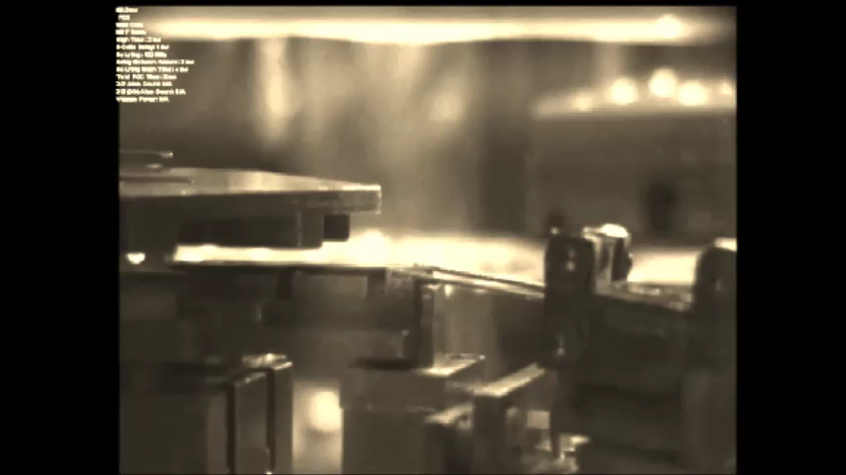
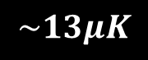
How does it work?
$$\sim 13μK$$

Slide 13
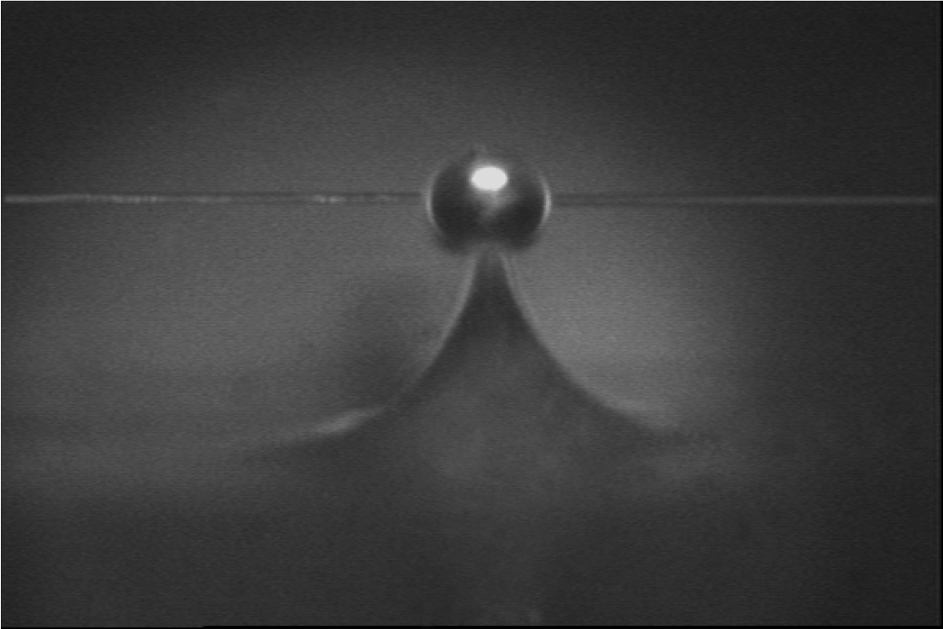
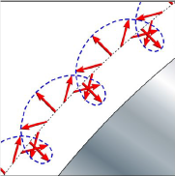
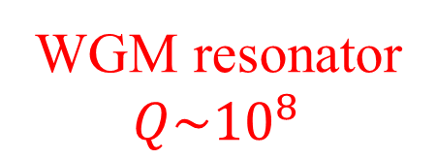
Rb
Rb
Rb
How does it work?
WGM resonator
$$Q\sim {10}^{8}$$
Nanofiber
TM modes
0
F’=0
σ ⁺
σ ⁻
F=1
−1
+1
Junge et al., PRL 110, 213604 (2013)

Slide 14
How does it work?
Rb
Frequency Locking
Single atom detection
0
F’=0
σ ⁺
σ ⁻
F=1
−1
+1

Slide 15
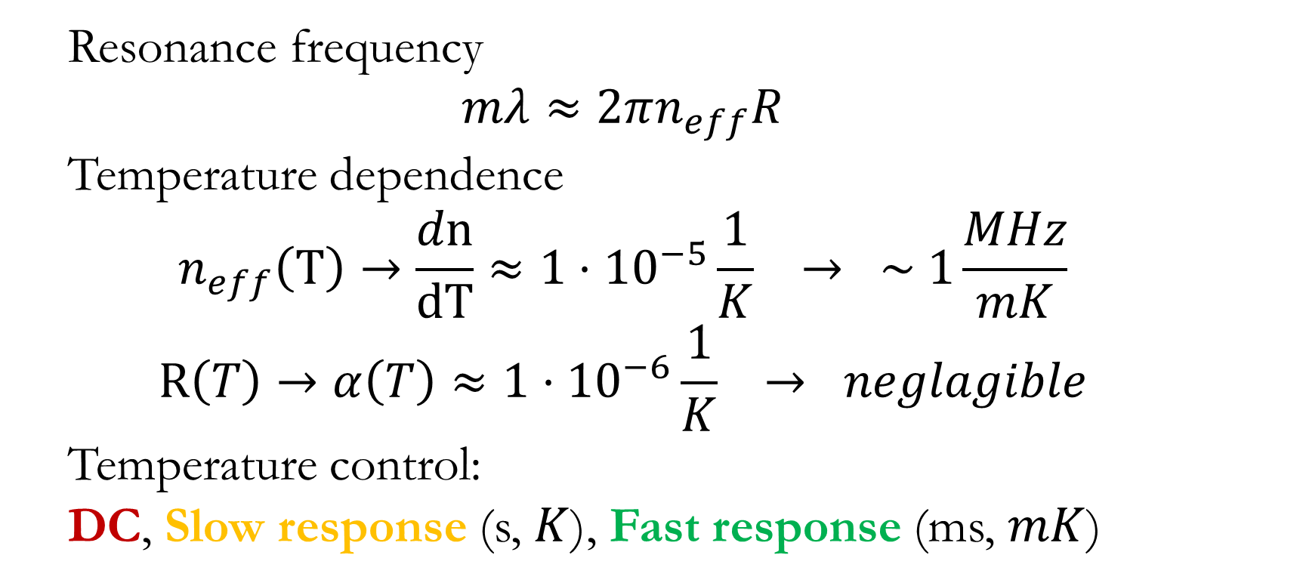
Locking the resonator frequency
Resonance frequency
$$mλ≈2πn_{eff}R$$
Temperature dependence
$$n_{eff}\left(T\right)→\frac{dn}{dT}≈1⋅{10}^{−5}\frac{1}{K} → \sim 1\frac{MHz}{mK}$$
$$R\left(T\right)→α\left(T\right)≈1⋅{10}^{−6}\frac{1}{K} → neglagible$$
Temperature control:
DC, Slow response (s, $K$), Fast response (ms, $mK$)

Slide 16
Locking the resonator frequency
Vacuum Chamber
d
Nanofiber
Microsphere Chip
Tapered fiber
Microsphere
TEC
DC – Piezo feedback loop duty-cycle
Slow – TEC
Fast – Green laser pointer
X,Z Piezo

Slide 17
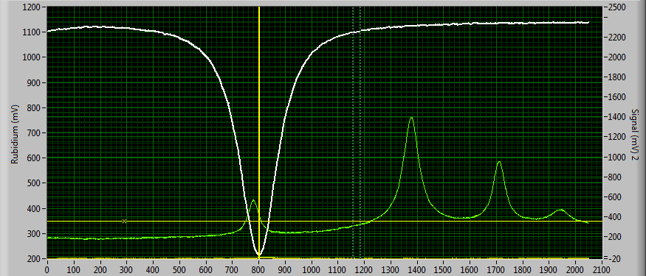
Locking the resonator frequency
Locking:
Resonance scan – “high power” light
Experiment:
“Single photon” light

Slide 18
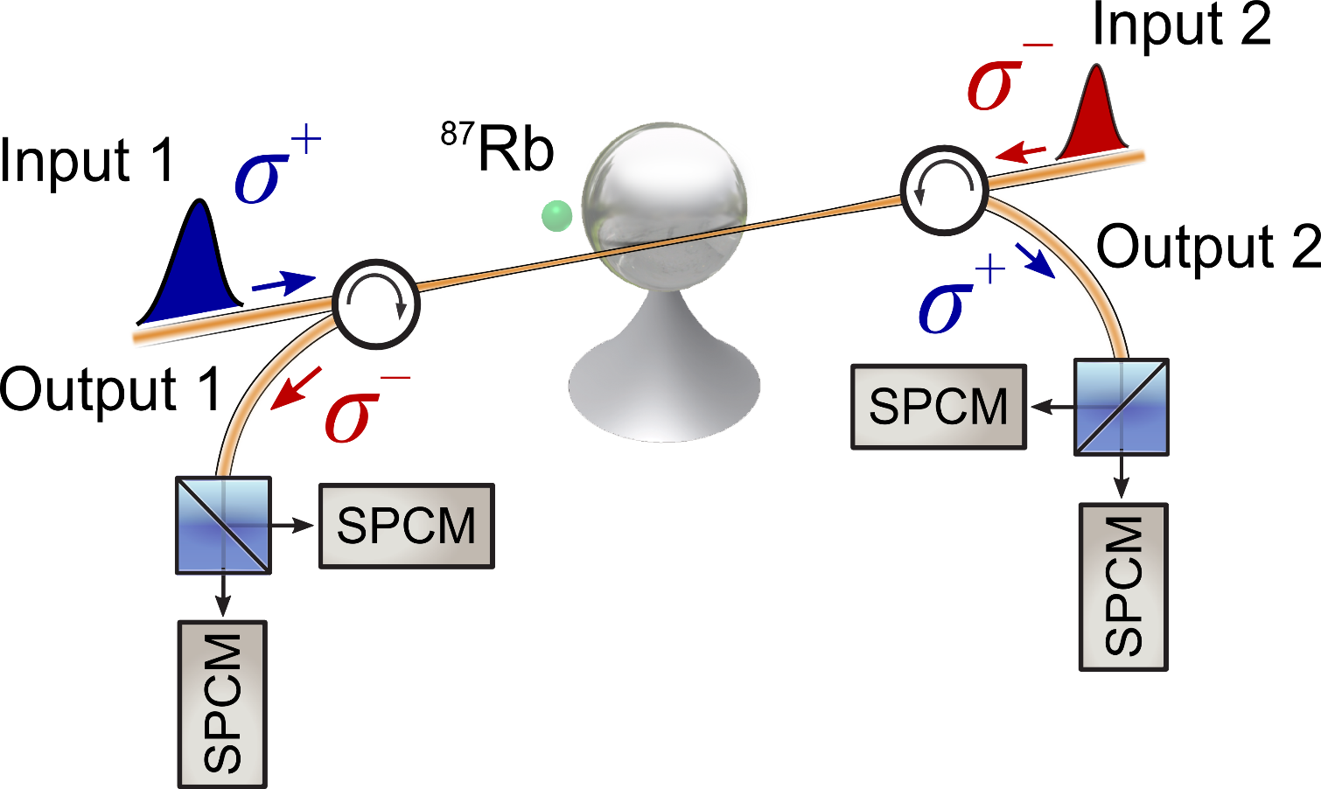
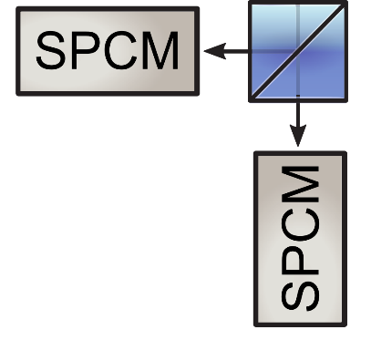
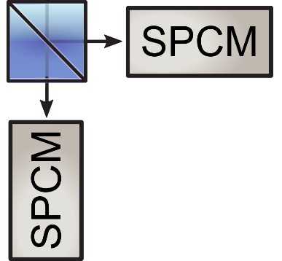
Locking the resonator frequency
Locking stage
High power goes to APDs and temperature is adjusted
CW
APD
APD

Slide 19
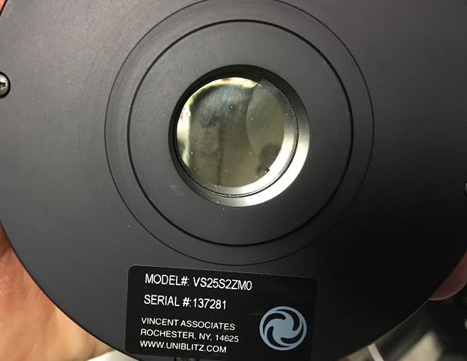

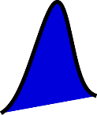
Locking the resonator frequency
Experiment stage
“Single” photons go to SPCMs
APD
APD

Slide 20
Single atom detection
Rb
Single atom detection
0
F’=0
σ ⁺
σ ⁻
F=1
−1
+1

Slide 21
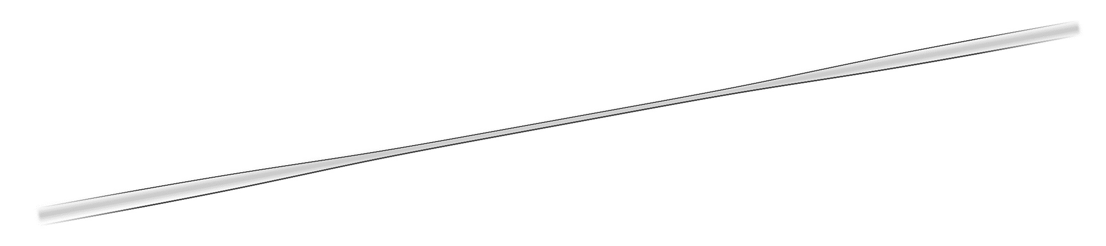
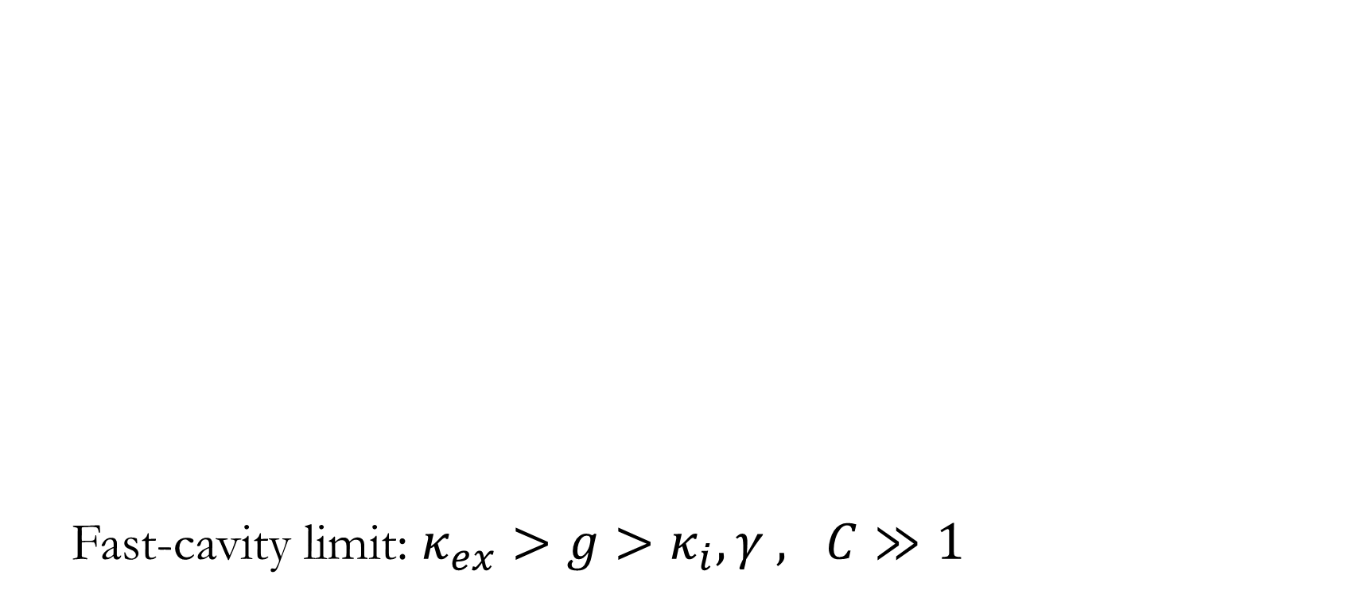
Photon-Atom interaction
Fast-cavity limit: $κ_{ex}>g>κ_{i},γ , C≫1$
−1
+1

Slide 22
Single-photon Raman interaction (SPRINT)
-1
1
∼ 0
x
-1
−1
+1
Unit absorption
Pinotsi and Imamoglu, PRL 100, 093603 (2008)
Rosenblum, Parkins and Dayan, PRA 84, 033854 (2011)

Slide 23
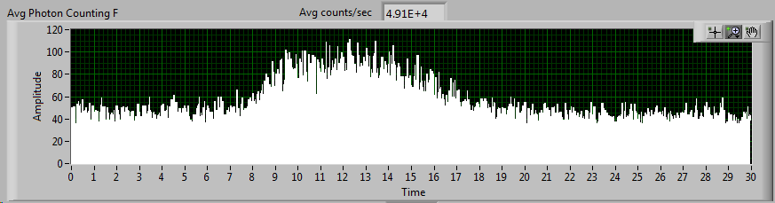
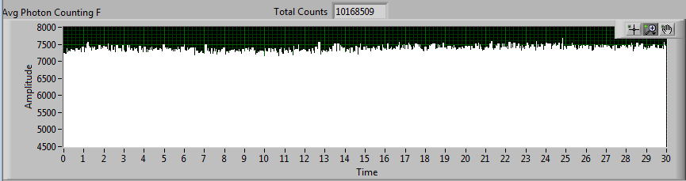
Transit measurements
−1
+1

Slide 24
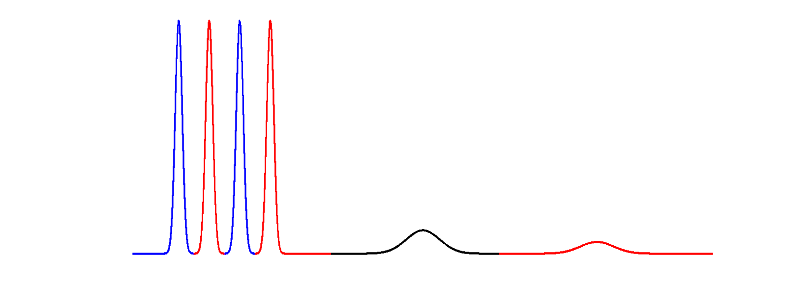
Experimental sequence
Atomic detection
And preparation
Atomic detection
And preparation
−1
+1
Experiment

Slide 25
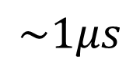
Post-selection
$$\sim 1μs$$
Experiment

Slide 26

The problems with falling atoms
Avoid having two atoms at the same time Small probability of a single atom interacting with cavity
Short transit time
Data collection rate ~ 1data point/200 drops $→$1experiment = 1 month 24/7
Atom transit ~ 1us -> limits experiment complexity, limits fidelity

Slide 27
Single atom trapping
Optical trap
Load the atom - Slow atom velocity

Slide 28
Single atom trapping
Optical trap
Slow atom velocity

Slide 29

Atomic fountain

Slide 30
Single atom trapping
Optical trap
Slow atom velocity

Slide 31



Optical trap
Dual-wavelength evanescent field trapping of a single atom.
$$U_{dipole}=ℏδ\frac{s}{2\left(1+s\right)}$$
$$U_{vdw}=−\frac{c_{3}}{r^{3}}$$
E. Vetsch, et.al., PRL, 104, 203603 (2010)

Slide 32



Optical trap – A suitable resonator
Mode overlap
Many modes

Slide 33




Optical trap – A suitable resonator
Mode overlap
Sphere
??????
Nano-fiber
Microtoroid
Microsphere

Slide 34





Optical trap – A suitable resonator

Slide 35





Optical trap – system upgrades
z

Slide 36





Assaf
Adi
Oded
Gabi
Dor
Adrien
Ran
Niv
Ori
Ziv
Tal
Barak
Moran
Thank You

